Slide 1
Vector Tools for Computer Graphics
Computer Graphics

Slide 2
Basic Definitions
Points specify location in space (or in the plane).
Vectors have magnitude and direction (like velocity).
Points ≠ Vectors

Slide 3
Basics of Vectors
v
Vector as displacement:
v is a vector from point P to point Q.
P
v
Q
The difference between two points is a vector: v = Q - P
Another way:
The sum of a point and a vector is a point : P + v = Q
Q
P
v
Notes:
Vectors are "directed quantity." For example: 5 steps in the east.

Slide 4
Operations on Vectors
Two operations
Addition
a + b
a = (3,5,8), b = (-1,2,-4)
a + b = (2,7,4)
Multiplication be scalars
sa
a = (3,-5,8), s = 5
5a = (15,-25,40)
operations are done componentwise

Slide 5
Operations on vectors
Addition
b
a+ b
a+ b
b
a
a
Multiplication by scalar
a
2a
-a

Slide 6
Operations on vectors
Subtraction
a-c
a-c
a
a
a
c
-c
c

Slide 7
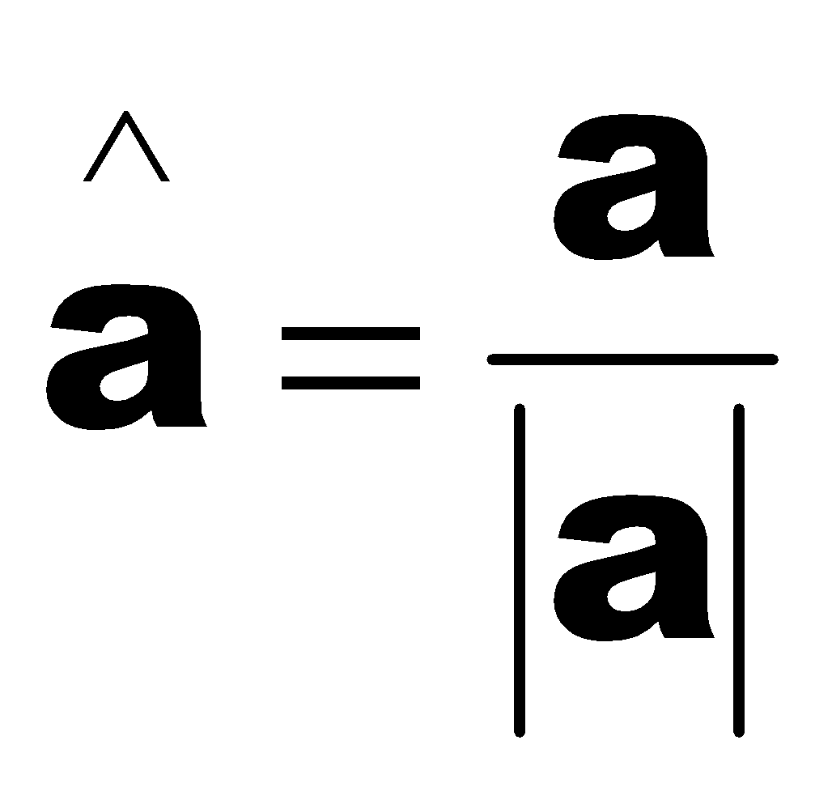
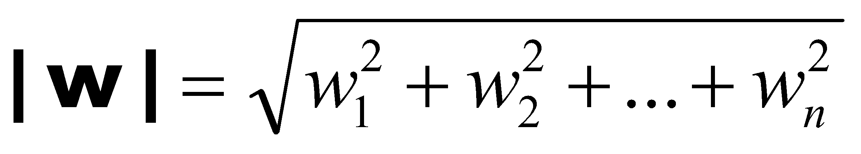
Properties of vectors
Length or size
w = (w₁,w₂,…,w_{n})
Unit vector
The process is called normalizing
Used to refer direction
The standard unit vectors: i = (1,0,0), j = (0,1,0) and k = (0,0,1)

Slide 8
Dot Product
The dot product d of two vectors v = (v₁,v₂,…,v_{n}) and w = (w₁,w₂,…w_{n}):
Properties
Symmetry: a·b = b·a
Linearity: (a+c) ·b = a·b + c·b
Homogeneity: (sa) ·b = s(a·b)
|b|² = b·b
Notes:
The dot product is literally measuring how aligned two vectors are.
If they point the same way → dot product is big and positive.
If they’re perpendicular → dot product is zero.
If they point opposite → dot product is negative.

Slide 9
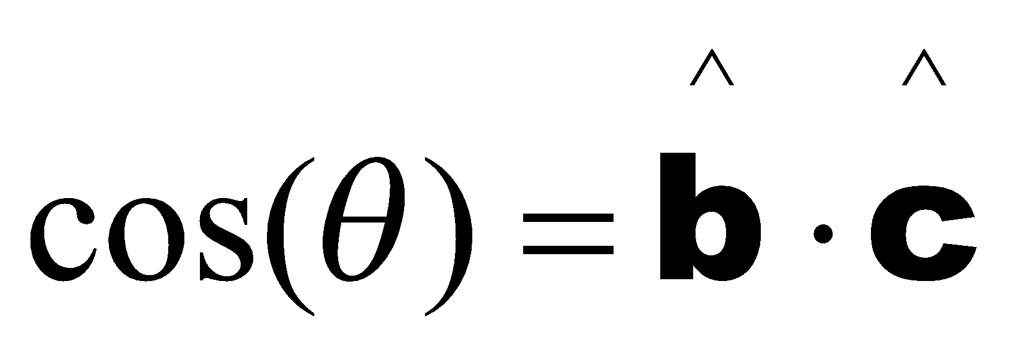
Application of Dot Product
Angle between two unit vectors b and c
y
c
b
θ
Φ_{c}
Φ_{b}
x
Two vectors b and c are perpendicular (orthogonal/normal) if
b·c = 0

Slide 10
2D perp Vector
Which vector is perpendicular to the 2D vector a = (a_{x},a_{y})?
Let a = (a_{x},a_{y}).
Then
a┴ = (-a_{y},a_{x})
is the counterclockwise perpendicular to a.
a┴
a
-a┴
a
What about 3D case?

Slide 11
Rotation in 2d
We want to rotate a 2d vector v counterclockwise by an angle A
First we determine perp(v), v┴
Then we scale v by cosA and scale v┴ by sinA and take their sum
v┴
vcosA + v┴sinA
v
v┴sinA
A
vcosA

Slide 12
Rotation in 3d
We want to rotate a 3d vector l counterclockwise with respect to a 3d unit vector r by an angle A, where l and r are perpendicular to each other
First we determine the vector u, that is perpendicular to both l and r and have a length equal to that of l
So, u = r X l
Then we scale l by cosA and scale u by sinA and take their sum
u
* note that, this method is applicable only in cases where the axis of rotation and the vector which is to be rotated are perpendicular to each other
l
usinA
A
lcosA
r

Slide 13
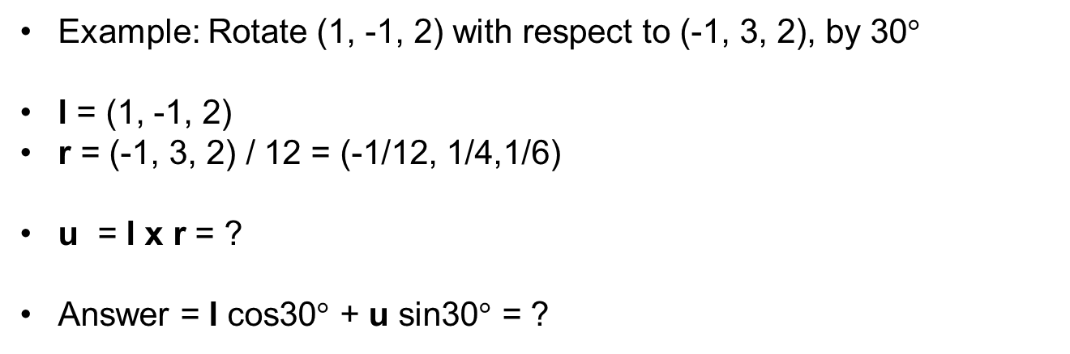
Rotation in 3d
u
l
usinA
A
lcosA
r

Slide 14
Orthogonal Projection
We want to decompose the vector c into two vectors, one along the direction of a unit vector v and another along perp(v)
The length of the orthogonal projection of c along v is c.v (as v is a unit vector)
Thus the component (or orthogonal projection) of c along v is (c.v)v
So the component of c along perp(v) is c-(c.v)v
c
v┴
v
c.v

Slide 15
Reflection [13]
n
n
a
r
a
r
θ
θ
m
-m
e
e
r = a - 2 ( a . n) n
Here m is the orthogonal projection of a along n
m equals (a.n)n as n is a unit vector
Notes:
e = a - m , e = r +m, a-m = r+m, r = a -2m, m is the horizontal component of a vector. And n is the negative unit vector along m. m= acosA*(-n) = ((-a).n) (-n)

Slide 16
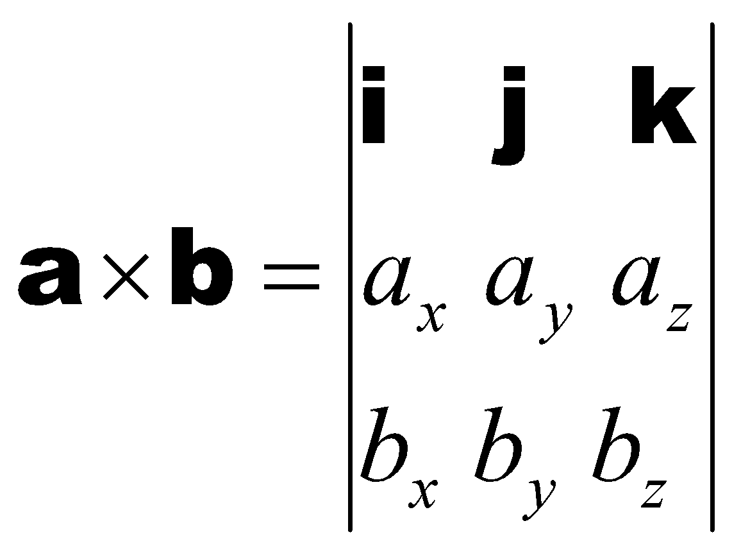
Cross Product
Also called vector product.
Defined for 3D vectors only.
Properties
Antisymmetry: a Χ b = - b Χ a
Linearity: (a +c) Χ b = a Χ b + c Χ b
Homogeneity: (sa) Χ b = s(a Χ b)

Slide 17
Geometric Interpretation of Cross Product
y
axb
a
P₁
P₃
b
P₂
x
z
aXb is perpendicular to both a and b
| aXb | = area of the parallelogram defined by a and b

Slide 18
Representing Lines [11][12]
Line
Ray
2 types of representations:
Two point form
Parametric representation

Slide 19

Parametric Representation of a Line
y
t > 1
B
v
t = 1
P
t = 0
t < 0
x

Slide 20
Planes in 3D
4 fundamental forms
Three-point form
Parametric representation
Point normal form
Equation

Slide 21
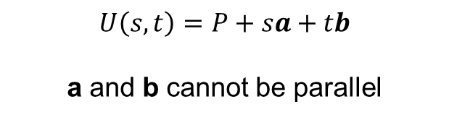
Parametric Representation of Plane
P
b
a

Slide 22
Point Normal Form of a Plane
n
B

Slide 23
Representations of Plane [13]
A=(0,0,n.C/ n_{z}) C=(C-0) B=(0,n.C/ n_{y},0)
Point
Normal
Three Point
{C, n}
{A,C, B}
n = (A-C)x(B – C)
a= (0,0,1)xn
A = C + a
B = C + b
b = nxa
n = axb
a= A – C
b = B – C
Parametric
{C, a, b}
Notes:
Parametric form of a plane P(s,t)=as+bt+C. pt normal to 3pt, pt normal to param

Slide 24
Equation of a Plane [1][2][3][4]
ax + by + cz + d = 0 is the standard equation of a plane in 3d
If sqrt(a^2 + b^2 + c^2) = 1, then it is called the normalized form
In the normalized form, |d| equals the distance of the plane from the origin
Y
How to convert between equation and the other forms?
(x, y)
n_{y}
n_{x}
p.n
What about distance from an arbitrary point?
P = (p_{x}, p_{y})
X
L

Slide 25
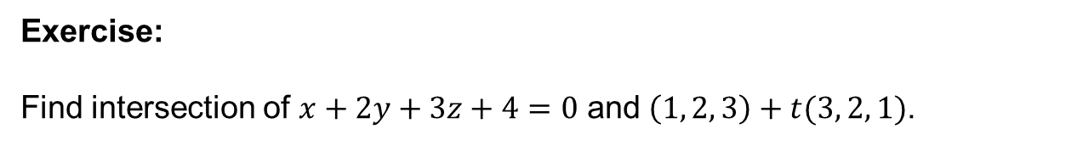
Line-Plane Intersection [8]
Plane: ax + by + cz + d = 0
Line: P + tV
Determine the specific value of t (say t’) for which the equation of the plane is satisfied, i.e., the point on the line lies on the plane

Slide 26
Line-Line Intersection [5][6][7]
Four possible cases:
Coincident
Parallel
Not parallel and do not intersect
Not parallel and intersect
Notes:
skew lines

Slide 27
Line-Line Intersection
L₁: P₁ + tV₁
L₂: P₂ + sV₂
Parallel if V₁ and V₂ are in the same or opposite direction (i.e., the angle between them are 0 degree or 180 degree)
Coincident if they are parallel and have at least one point in common
If they are not parallel, how to decide whether they intersect or not?
Notes:
Parallel if cross product 0

Slide 28
Line-Line Intersection
If they are not parallel, how to decide whether they intersect or not?
One solution
Generate three equations for two unknowns
Solve the first two equations to find a solution
Check whether the solution satisfies the third equation
Another solution
Check whether (P₁ – P₂).(V₁ X V₂) = 0
If lines intersect this condition must hold
If lines do not intersect, is it sure not to hold?

Slide 29
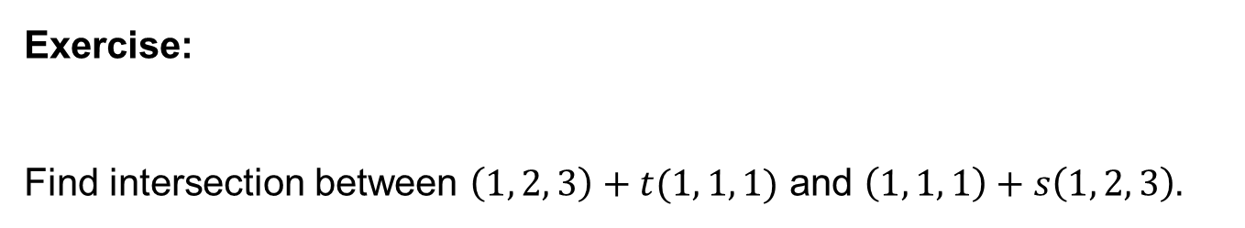
Line-Line Intersection

Slide 30
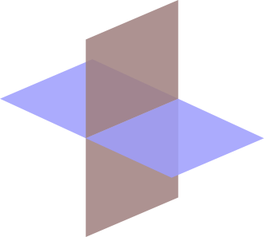
Plane-Plane Intersection [9][10]
Intersection is a line
So we need two points on the line, or one point and the direction
How to get a point on the intersecting line?
How to get the direction of the intersecting line?

Slide 31
Plane-Plane Intersection
How to get a point on the intersecting line?
Imagine another plane not parallel to the intersecting line, for example the plane z = 0 (the XY plane).
Now solve three equations to find their common intersection point

Slide 32
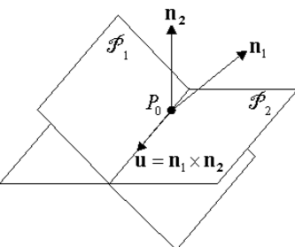
Plane-Plane Intersection
How to get the direction of the intersecting line?
Consider the planes in point-normal form
Plane 1: P₁, n₁
Plane 2: P₂, n₂
n₁ and n₂ are both perpendicular to the intersecting line
So the direction of the line of intersection is along n₁ X n₂

Slide 33
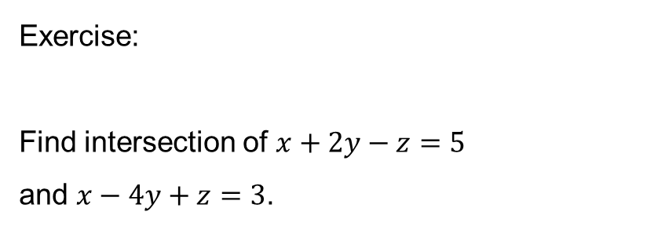
Plane-Plane Intersection

Slide 34
Links
[1] http://www.songho.ca/math/plane/plane.html
[2] http://mathinsight.org/distance_point_plane
[3] https://www.youtube.com/watch?v=gw-4wltP5tY
[4] https://www.youtube.com/watch?v=7rIFO8hct9g
[5] https://www.youtube.com/watch?v=nKVCvY-FW5Q
[6] https://www.youtube.com/watch?v=bJ56Xr9081k
[7] https://www.youtube.com/watch?v=r5DwyBFxD7Q
[8] https://www.youtube.com/watch?v=Td9CZGkqrSg
[9] https://www.youtube.com/watch?v=SoSTdgqknvY
[10] https://www.youtube.com/watch?v=LpardiBTAvU

Slide 35
Links
[11] https://www.youtube.com/watch?v=FlLbI7DB0SM
[12] https://www.youtube.com/watch?v=nZ2mS5M4fcQ
[13] (textbook) Chapter 4, Computer Graphics using OpenGL (2nd edition) by Francis S Hill, Jr.

